Slide 1



Platforms and Tools for Educational Video Games – А Literature Review
• Yavor Dankov, • Boyan Bontchev, • Valentina Terzieva, • Aleksandar Dimov
Faculty of Mathematics and Informatics,
Sofia University “St. Kliment Ohridski”, Bulgaria
28th Int. Conf. on Interactive Collaborative Learning (ICL’2025) Innovation via Collaborative Learning in Engineering Education
01–03 October 2025, Budapest University of Technology and Economics, Budapest, Hungary

Slide 2

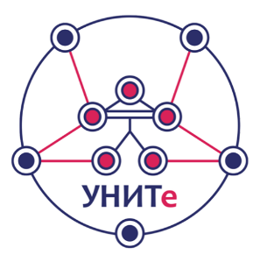
Agenda
Introduction to serious video games for learning
Software tools for creation of educational video games
Research questions
Methodology
Findings
Discussion
Conclusion remarks

Slide 3
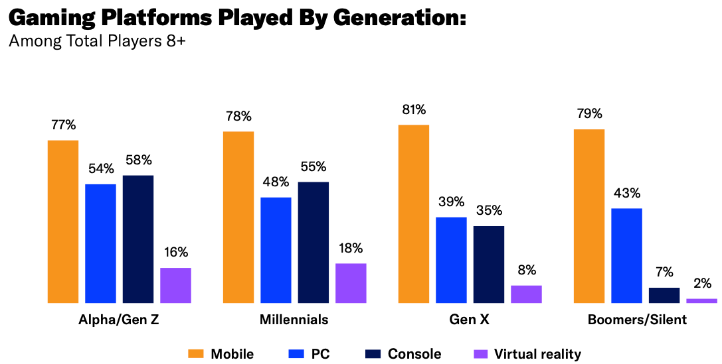
Introduction
Traditional teaching suffers from low learner motivation, few practical and interdisciplinary examples, and limited interactivity.
Generation Z/Alpha expect experiential learning to improve their critical thinking and decision-making skills
Serious video games for learning and education add interactivity, immediate feedback, safe failure, and personalization

Slide 4
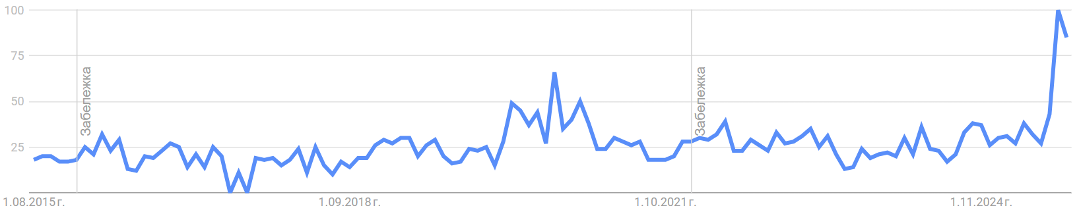
Serious Video Games for Learning
“A serious game or applied game is a game designed for a primary purpose other than pure entertainment” (Abt, 1970)
Serious video games for learning offer several benefits, such as:
increased involvement and engagement among learners,
higher possibilities for applying real-world educational scenarios and didactic simulations, and
personalized learning experiences
Google Trends:

Slide 5
Serious Problems with the Serious Games
Higher development cost
Lower attractiveness compared to entertainment games
Transition between instructional design and actual game design implementation – how Game Mechanics impact and interact with the Learning Mechanics
Assessment – effectively tracking and analyzing the proper parameters related to learners’ progress (knowledge gain, reflection, and application)
How should psychological theories be used to design realistic and convincing non-player characters (NPCs)?
How do different pedagogical paradigms relate to tailoring SG and its mechanics (by personalization and adaptation)?
There are a few platforms and tools for easy creation of educational video games by teachers and educators
D1.6 GALA Roadmap 2, Nov. 2011

Slide 6
Software Tools for Creation of Educational Video Games
Authoring learning objects and scenarios
Design of educational video games
Development of educational video games
Generation of educational video games
Kahoot
Minecraft
Quizizz
Genially
Nearpod
Scratch
APOGEE

Slide 7
Research Questions
Researchers in the field need more systematic reviews and classification of existing platforms and tools to understand better their applications for the practical creation of educational games
Research questions:
RQ1: What are the most common purposes of platforms and tools for creating educational video games?
RQ2: What tools are most commonly used for creating educational video games?

Slide 8
Methodology 1/2
Preferred Reporting Items for Systematic Reviews and Meta-Analyses (PRISMA) – for a transparent and comprehensive reporting of a systematic quantitative review
Research databases: Scopus and Web of Science (WoS):
Period: 2015-2025
Collected content: title, authors, authors’ institutions, abstract, keywords, DOI, Web address, and citation count
Stage 1 – aimed at finding the most popular and used platforms and tools for video game creation purposes, including modelling, authoring, design, development, generation, and gamification
Search queries for Stage 1:
SQ1=(“education* computer game*” OR “education* video game*” OR “learning game*” OR “serious video game*” OR “serious computer* game*”) AND (creat* OR buil* OR generat* OR compose* OR construct*) AND (tool* OR instrument* OR platform* OR software OR means)
SQ1.1=SQ1 AND (modelling OR authoring OR design OR development OR generation OR gamification)

Slide 9
Methodology 2/2
Stage 2 – uses the names identified platforms and tools during the processing of results from SQ1, such as Scratch, Kahoot!, Minecraft, Quizizz, Classcraft, APOGEE, etc. – as <NameOfPlatform>
Research databases: Scopus and Web of Science (WoS)
Publication type:
Period: 2015-2025
Collected content: title, authors, authors’ institutions, abstract, keywords, DOI, Web address, and citation count of the found documents
Search queries for Stage 2:
SQ2=<NameOfPlatform> AND (platform* OR tool* OR instrument* OR software* OR mean*) AND (game* OR gaming) AND (learn* OR education*)
The qualitative analysis was conducted by the ATLAS.ti tool

Slide 10
Inclusion/Exclusion Criteria
Inclusion criteria:
1) the articles had to be related to the research topic;
2) the articles had to be focused on educational video games, or varieties of serious games;
3) articles must be published only in English;
4) articles must be of the types conference paper, journal article, book, and book chapter.
Exclusion criteria:
1) publications that are not related to educational or serious video games;
2) publications for which there is not enough presented information in the abstract or title, from which it is unclear whether there is a direct connection to the study;
3) publications that are not related to the research questions posed.

Slide 11
Results
Found scientific publications:
270 in the Web of Science database
386 in Scopus
Open access (green, silver, and gold) publications:
27 % for Scopus
30% for WoS
After removal of duplicates: 457 publications left
After application of Inclusion/Exclusion Criteria: 321 publications left

Slide 12
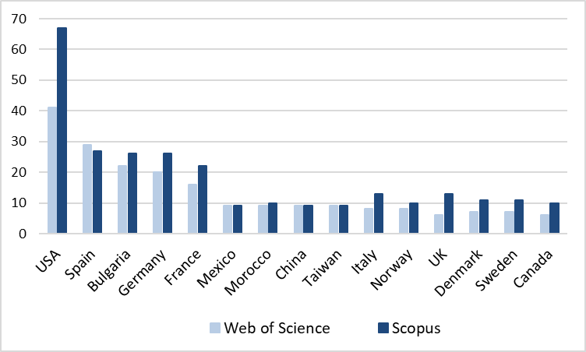
Distribution of Publications Found in WoS and Scopus for the First 15 Countries
62% from all 656 publications

Slide 13
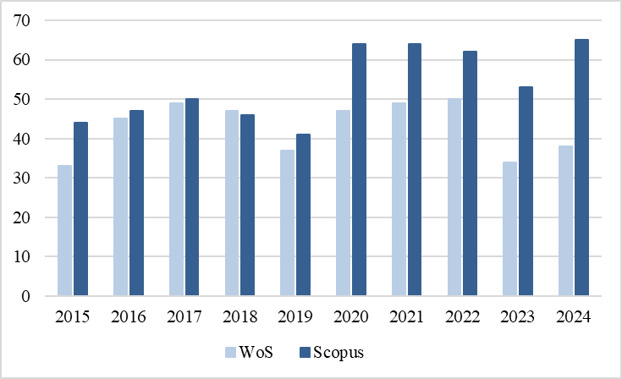
Distribution of Publications Found in WoS and Scopus by Year

Slide 14
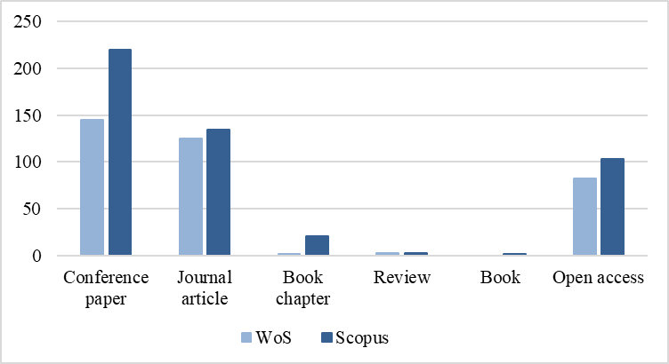
Distribution of Publications Found in WoS and Scopus by Type

Slide 15
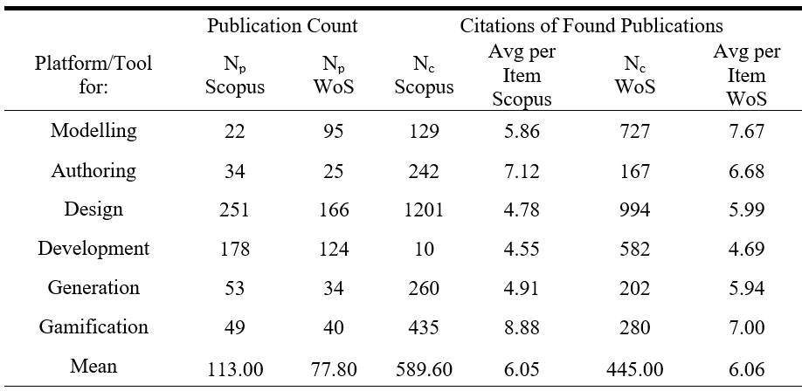
Number of Publications About Types of Platforms and Tools plus Citations Found in Scopus and WoS

Slide 16
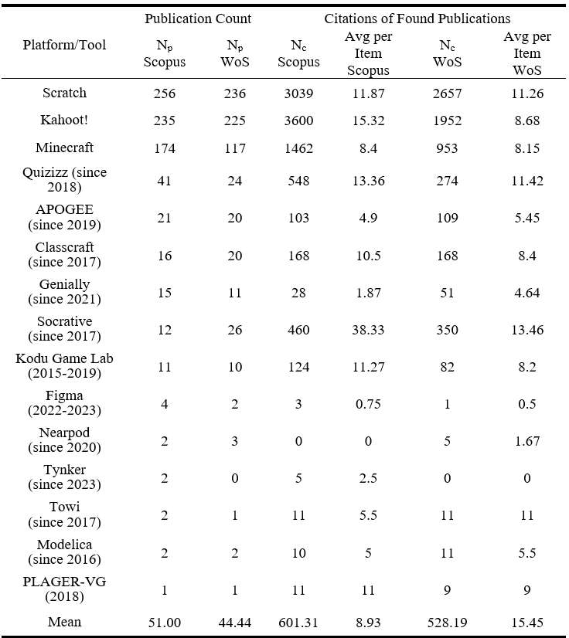
Number of Publications About Platforms and Tools plus Citations Found in Scopus and WoS

Slide 17
Pearson Correlations
Very strong positive correlations were found between:
the numbers of publications found in Scopus and WoS (r=0.98772, p<0.00000) and, as well,
between the numbers of their citations in both the databases (r=0.82319, p<0.00000).
A weak negative correlation was found between the average numbers of citations per publication (r=-0.10558), which appeared not to be statistically significant.

Slide 18
Discussion 1/2
RQ1:
The platforms and tools are applied mainly for the design and development of educational video games, and several times less for their modelling, authoring, and generation
Evolution of instruments facilitating the gamification of learning processes for making them more engaging and appealing for pupils and students

Slide 19
Discussion 2/2
RQ2:
16 software platforms and tools specifically designed for modeling, design, development, and/or generation of such games.
The triad of Scratch, Kahoot!, and Minecraft represents the most popular platforms for educational video game creation
Quizizz, APOGEE, Classcraft, Genially, Socrative, and Kodu Game Lab – all of which have been featured in numerous publications in Scopus and WoS, garnering hundreds of citations
Figma, Nearpod, Tynker, Towi, Modelica, and PLAGER-VG are presented in isolated research publications and few or even zero citations
Kodu Game Lab, Figma, and PLAGER-VG, are discontinued
Scopus is a more inclusive database than WoS – it encompasses approximately 20-30% more publications related to platforms and tools

Slide 20
Limitations of the Study
PRISMA bias toward well-cited networks; may miss some work
English-language publications are only useful for tracking enduring characteristics across time
Very short period – 2015-2025
Only WoS and Scopus

Slide 21
Conclusions
We answer two main questions to understand the most common purposes of platforms and tools used for creating educational video games, and which tools are most commonly used for this purpose.
The results show that most tools are primarily applied for designing and developing educational video games, rather than for modeling and authoring such games.
Several tools, such as Scratch, Kahoot, and Minecraft, are significantly more widely used by the community.
Directions for further research include:
Investigating the usability of platforms between teachers and educators who are not IT specialists.
The effectiveness of the identified platforms should be evaluated for applicability in education by such teachers.

Slide 22

Thank You for Your Attention!
If you have any questions, write to us:
yavor.dankov@fmi.uni-sofia.bg
bbontchev@fmi.uni-sofia.bg
valentina.terzieva@iict.bas.bg
aldi@fmi.uni-sofia.bg
The authors gratefully acknowledge the support provided by the project MOTIVATE, funded by the Bulgarian National Science Fund, contract No. КП-06-Н85/2 dated 05/12/2024, and by the project UNITe BG16RFPR002-1.014-0004 funded by PRIDST.

